Slide 1
How Young People with SEND can be supported into Employment

Slide 2



Multi agency working
Travel Training
Post 16 Providers
Development work with SENCO’s
Parent/Carer Groups
SI Employer follow up
SEND Focus Groups
Children & Adult Services Transition

Slide 3

Delivery Model
Working with Adult Social Care to integrate supported internships and inclusive apprenticeships as part of preparing for adulthood and transition and provide on-going support in employment if needed
Engaging with employers to secure supported internship and apprenticeship opportunities for young people with disabilities
Negotiating with large employers to ring-fence a number of potential internship placements which would lead to a paid apprenticeship or job carved part-time role

Slide 4

Partnership Working
Young person with disability
Family
Local Authority, ASC, SEND Team
Enable, Supported Employment Services
DWP - Access to Work
Education Provider
Supported Internships

Slide 5

Process for referrals to Shropshire’s Enable’s Disability Supported Employment Service
Social Care Team
(if person is already open or receiving a Social Care service )
Day Opportunities
Autism Hub
Self Referral / Other Team Contact First Point of Contact 0345 6789044
to arrange Adult Social Care assessment at a local hub
If paid work is not required Enable to discuss with the referrer and explore Personal Budget possibilities if appropriate
Person Centred Initial Assessment involving Circle of Support carried out with Enable Employment Specialist
Vocational Profile started
CV Building / Interview preparation / Benefit situation clarified
In work support:
Travel Training
Job coaching
Reviews
Retention Work
Planned withdrawal

Slide 6

LUKE
Luke completed a supported internship in 2016 and was supported by Enable to secure an inclusive apprenticeship with Edinburgh Woollen Mill.
Enable liaised with the college, sensory inclusion team, the employer and training provider to ensure the right support was in place for him.
Luke has now completed his apprenticeship and is supporting new Supported Interns in his new role

Slide 7
Jaimie
Jaimie is Shropshire Council’s first
inclusive apprentice and he is a great
example of how the inclusive apprenticeship
opens doors and opportunities.
Jaimie was travel trained by Enable when he was 16 to attend SCG for a College ready course, he then started his Supported Internship in the IT team at Shropshire Council the following year.
In his 3rd year, at age 18, Jaimie was supported by Enable to progress to the inclusive apprenticeship in the START team at Shropshire Council.
Jaimie has now completed his first year and is making excellent progress.

Slide 8

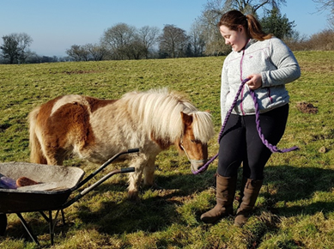
Georgia comments: "Being able to work with horses is a dream come true. Nothing else interests me nearly as much. With the help of my mentors Brendan and Paul I feel I have earned my apprenticeship. It's taken a lot of hard work, often in the cold and wet, and there is a lot more of that ahead but it's worth it”
“dreams come true”
Georgia's passion is horses. Having already been on a work experience placement in a commercial stable, she needed a structured route which made her an attractive candidate for a formal apprenticeship.
During the 12 month Supported Internship, Enable worked closely with an established Shropshire riding centre to ensure Georgia received thorough grounding knowledge in stable and yard skills support her gaining an equine apprenticeship and County Training arranged tuition in English and Maths to reach the minimum apprenticeship entry grades. A mentor from Enable was available to spend time alongside her at the stables to support her with any work-related difficulties personal issues such as motivation or clarity of direction.
Enable also arranged for a placement one day each week at Lower Bush Farm, which welcomes students with a variety of physical and learning difficulties. This gave her experience working with sheep, chickens, goats, horses, rabbits, guinea pigs, peacocks and even a snake, the latter of which presented a challenge Georgia.
Enable encouraged Georgia to apply for an apprenticeship position with an organisation they worked closely with and obtained an introduction and recommendation. Following an informal interview, Georgia was delighted to be offered an apprenticeship.
“We had heard very little about Supported Internships until we were visited at home by a representative from "Enable". Our daughter, Georgia has Special Educational Needs and has not had the most academically successful. Enable vet all companies who are totally "on board" with the aims of the internship” Georgia’s Father
Our Involvement
“Never intrusive, the transition team were always there to support Georgia, enabling her to be a valued and respected member of the team during her placement in her own right, improving in confidence and self-esteem along the way” Tracey Newell, Senior Employment Officer

Slide 9
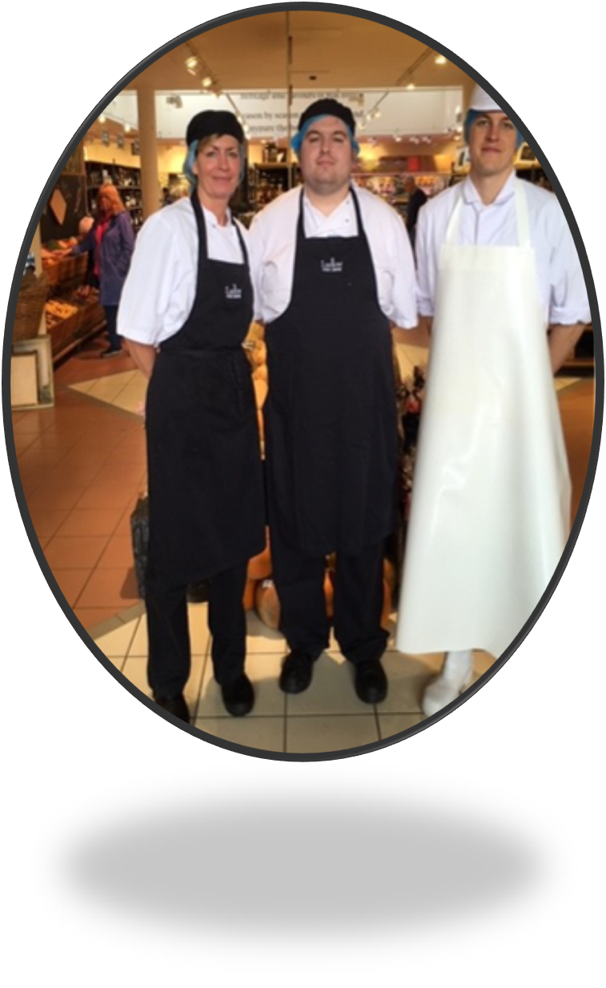
BEN
Ben has completed his Supported internship at Ludlow Farm shop
Enable have completed regular reviews in the work place and have successfully negotiated his progression
Currently liaising with his College apprenticeship team and his current tutors to ensure Ben is able to complete the apprenticeship standards
Ludlow Foods have agreed to offer Ben an apprenticeship in Bakery
Inclusive Apprenticeship will be delivered to suit Ben’s needs, the team are supportive and we are discussing job coach support needs and putting this in place.
Ben will do his first year under Supported Permitted Work

Slide 10

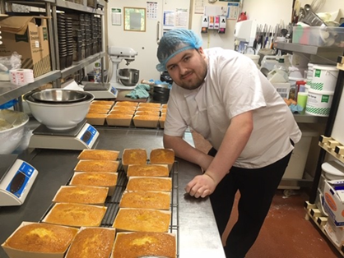
Feedback and Testimonials
“Our young people listen to their Peers and if they see someone who was in their school/class in employment it makes them think – I can do that” Annie parent of young person with SEND and PACC representative
Case Studies are widely accessible to ensure the message and information is cascaded to all
“Life changing for the whole family”
Ben has completed his Supported Internship at Ludlow Farm shop and he is so excited as he has been offered a 24 hour per week inclusive apprenticeship position in the bakery.
The Transition Team worked closely with his Tutor from the Specialist School he attended, the training provider delivering the inclusive apprenticeship, Ben’s parents and Social Worker. Working together to ensure the apprenticeship was the right option so Ben would have a smooth transition from full-time education to work.
A work place visit from the Assessor and meetings with his employer was arranged to ensure the potential job would meet the needs of the Apprenticeship standards.
We also asked Ben’s mum to discuss the employment and encourage Ben to accept the possibility of weekend work. Ben was so excited as he enjoys working with all the staff who value him as a key member.
Ben has confidence and now believes in himself
Values the Supported Internship so much, he plans to be a speaker at our Celebration Event
Positive Knock on affect
With ben’s fantastic news and success, his mum Sara now feels she has the independence to find her own employment which she has not been able to do for several years. This will have a great impact on her mental health and wellbeing but also for financial stability for the whole family.
“The Success of Ben’s Story is down the integrated service he has received from Shropshire Council; all the teams working together to ensure the necessary support to achieve his potential”

Slide 11
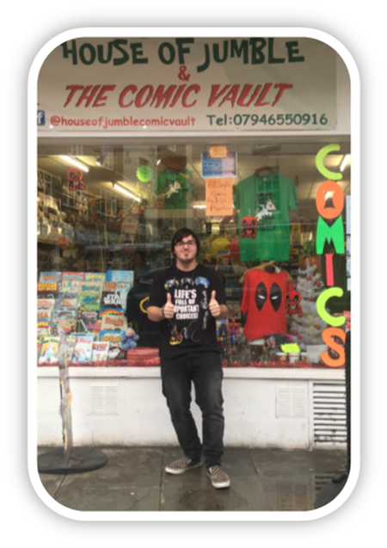
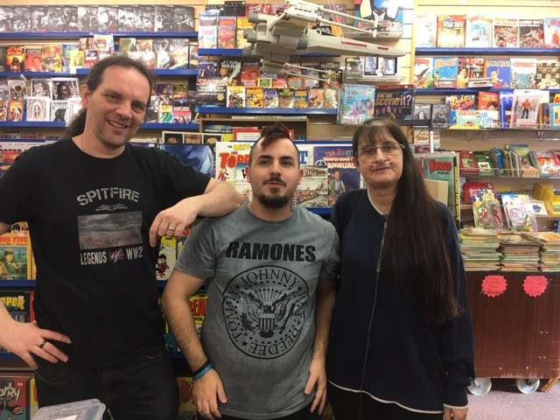
Jay
Jay completed his supported internship in July 2018 and progressed to an inclusive apprenticeship.
Jay said: “Its great talking to customers, I find it interesting speaking about things, I’ve started helping people to use the arcade machines and I am able to give advice to parents of young people with Autism as I have first-hand experience. My step dad came into the shop and was really surprised at how outgoing I was here as I am very quiet and reclusive at home. I’m really enjoying working here.”
Glen and Kate, Jay’s Managers, have confirmed that Jay has grown in confidence since starting with them and is very comfortable with approaching customers.

Slide 12
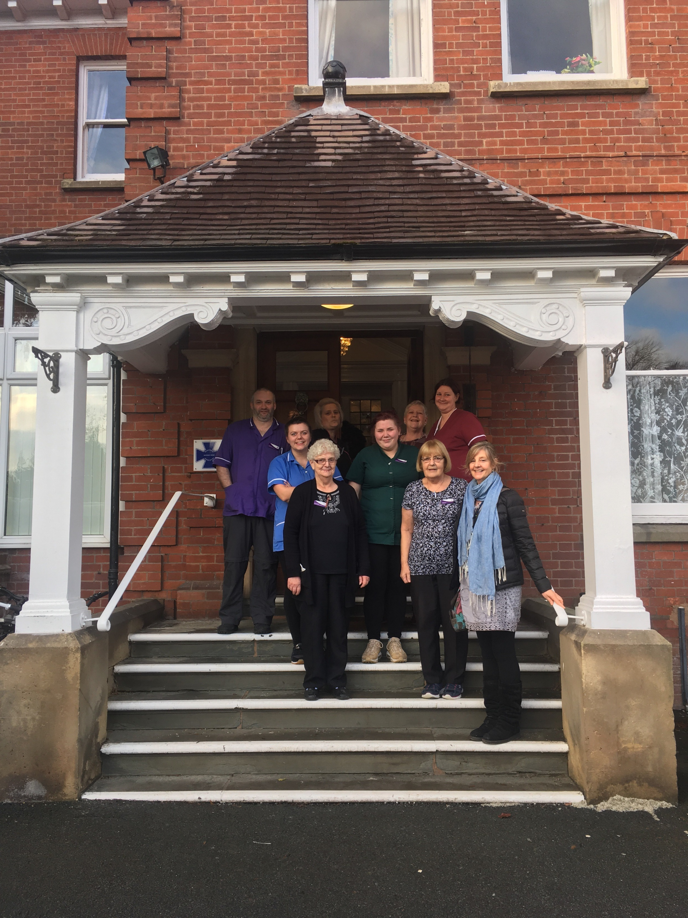
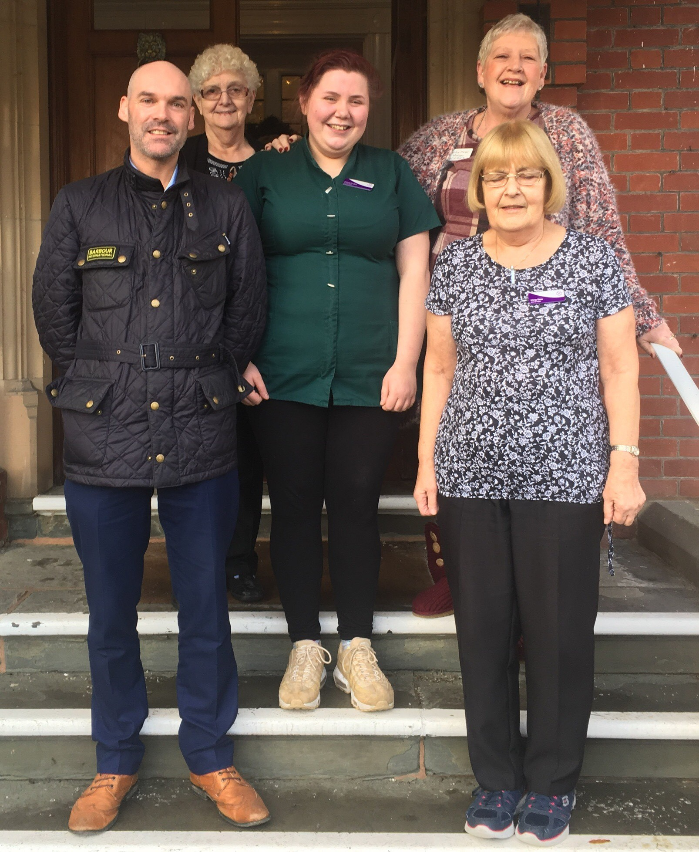
Importance of on-going support post Supported internship
Fran completed her Supported Internship in 2017 and progressed to paid employment
She remained in employment for 2 years
Enable Disability team now supporting Fran to find another role

Slide 13
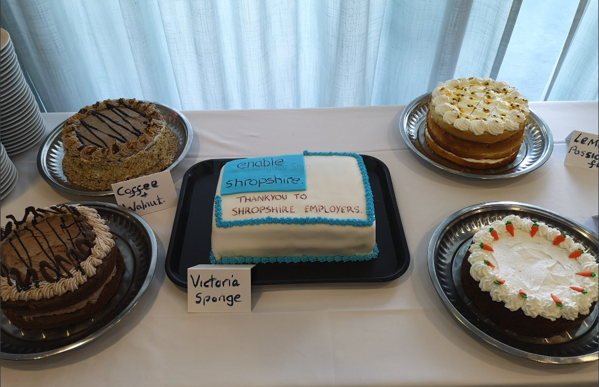
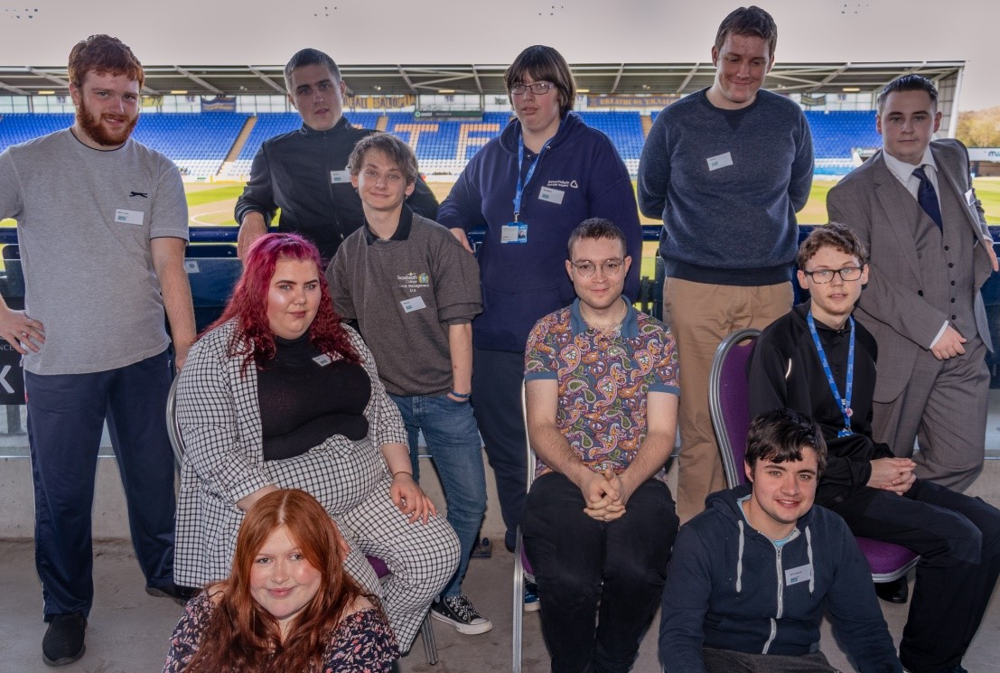
Key Factors to Success
Partnership working – Enable, post 16 Providers, Employers
Involvement of ASC Transition team
Progression planning post SI
On-going support after the Supported internship/inclusive apprenticeship/progression into job carved roles/paid employment
Tracking of interns and apprentices after completion
Celebrate success
.

Slide 14

VIDEOS
Play Carmar tea rooms
Jaimie video

Slide 15
01743 276900
www.enableservices.co.uk

Slide 16
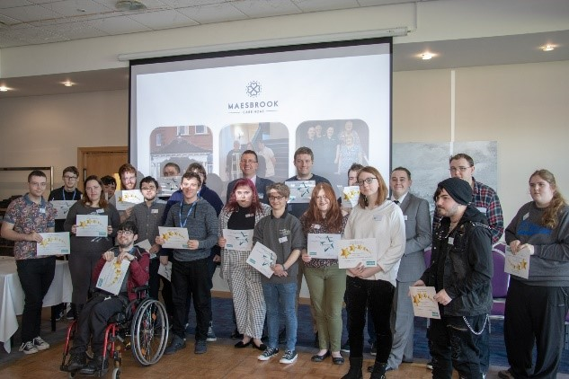
QUESTIONS

