Slide 1
Welcome to the PACC Conference and Annual General Meeting
26th March 2019
Information & Support, Influence & Change

Slide 2
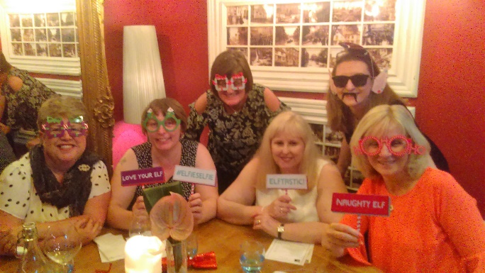
Plan for the Day
Welcome and housekeeping
Exploring Life as a parent carer – Hannah Prior, Ignition
Lunch
PACC AGM
Refreshments and catch up
Information & Support, Influence & Change

Slide 3
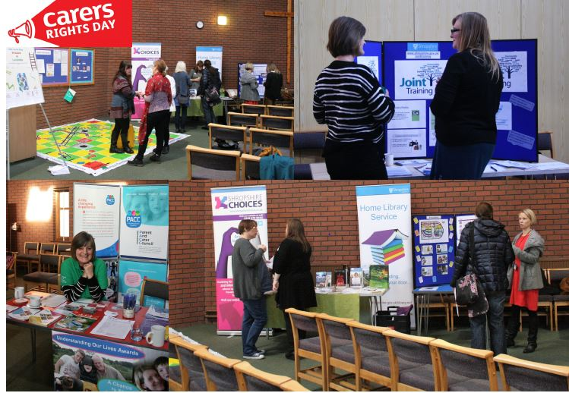
PACC Annual General Meeting 2017/18
Introduction
Membership
Finances
Chair Report
Vote in Management Board/Trustees
Information & Support, Influence & Change

Slide 4
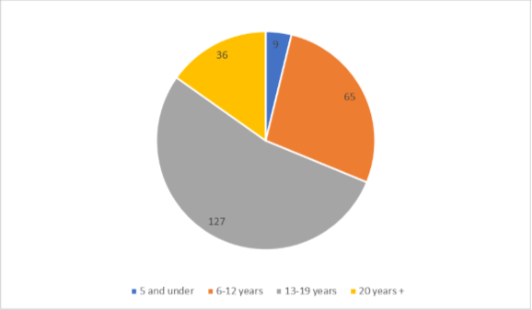
Membership
Following the requirement to re register following the implementation of the Data Protection Regulations PACC currently has 237 parent carer members on its database
Age of eldest child
Information & Support, Influence & Change

Slide 5
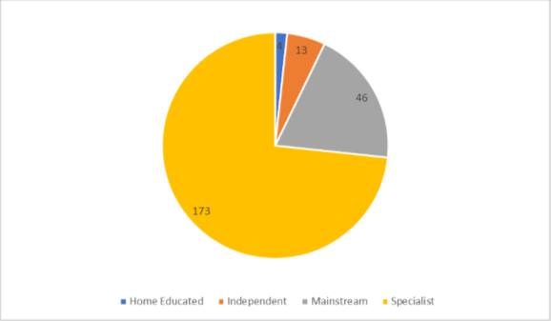
Membership
Education type of eldest child
Information & Support, Influence & Change

Slide 6
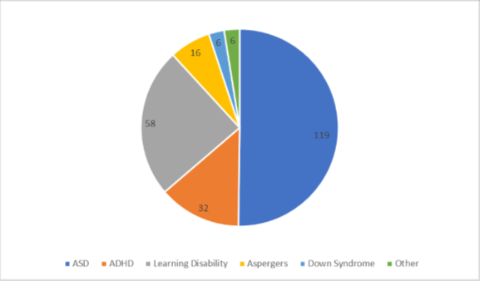
Membership
Disability or additional need of eldest child
Information & Support, Influence & Change

Slide 7
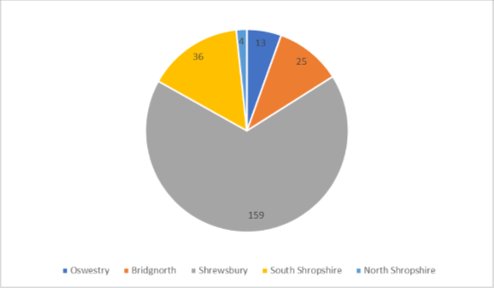
Membership
Geographical breakdown
Information & Support, Influence & Change

Slide 8
Finance
2017/18
Core Income
Dept For Education - £18,510
SEND Games (Shrops Council) - £1750
Participation Co-Ordinator and Administrator (Shrops Council) - £30,225
Core areas of expenditure
Salaries
Mileage
Postage
Events
Printing
Accountancy
Feeshttp://apps.charitycommission.gov.uk/Showcharity/RegisterOfCharities/CharityWithoutPartB.aspx?RegisteredCharityNumber=1150180&SubsidiaryNumber=0
Information & Support, Influence & Change

Slide 9
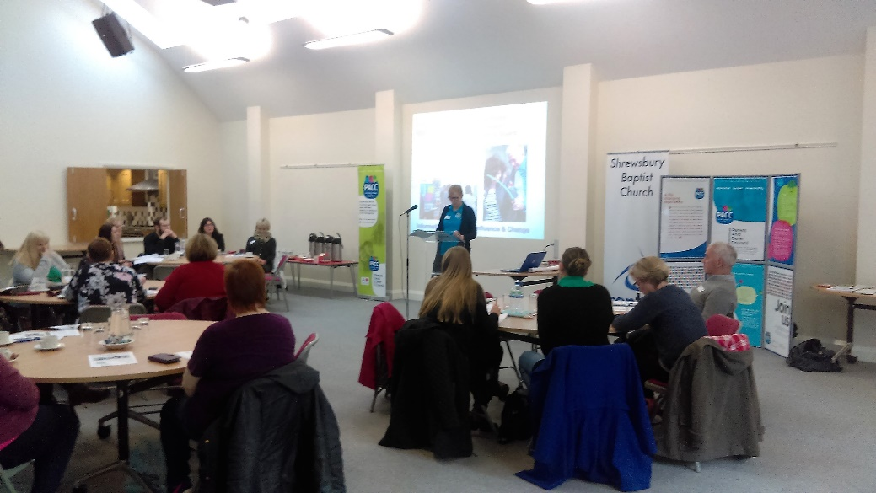
Chairs Report
2017/18
Co Chairs;
Zara Bowden
Mike Thomas
Information & Support, Influence & Change

Slide 10
Management Board / Trustee
Elections 2017/18
Re-standing;
Sarah Thomas
Zara Bowden
Natalie Hughes
Mike Thomas
Information & Support, Influence & Change

