Slide 1
Healthy Lives Programme 2023
Celebration Event
Information & Support, Influence & Change

Slide 2
10:00 | Welcome
10:10 | Seated Yoga activity
10:30 | Summary Presentation
10:40 | Photo highlights presentation
10:45 | Awards
11:15 | Rock! Music school performance
11:30 | Identity School of Dance
11:45 | Learning and Next Steps
12:00 | Lunch

Slide 3
Warm Up Activity

Slide 4
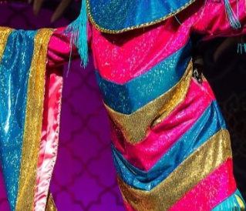
Can you guess who our special guest is?
“HELLO SHREWSBURY!”
(He might look a bit different today!)

Slide 5
Background
One of the challenges faced by SEND families is finding opportunities for their children and young people to participate in the community-based activities that others take for granted.
It is important that young people with SEND learn the value of looking after their own health and wellbeing as they become older. To understand to stay healthy, both physically and mentally is an essential part of preparing for adulthood.
With all of this in mind PACC worked with existing local activity providers to create our second PFA Healthy Lives Programme.

Slide 6
Programme aims
Programme aims
Providing a range of practical opportunities to practice healthy living, to improve health outcomes for young people with SEND.
Introducing young people from the SEND community who are in transition to adulthood, to existing inclusive activities, helping them to lead full and active lives.
To bring young people together to support the growth of peer friendships.

Slide 7
Providers
Rock! Music School
Nerdy Café
Cavalier Centre
Kiddly Divey at Albert Road
Arthog
Wolf Yoga
Shrewsbury Canoe Club
Drummonds Outdoor
All 4 Foundation
Condover College
Shrewsbury Sports Village
TSTC Disability Trampolining
The Hive
My Aspirations
Taylor Support
Lyneal Trust
Sabrina Boat
Mayfair Centre
Aquamira

Slide 8
The PFA (14-25) programme
74 young people attended the programme
386 session places were filled
Staff at pacc volunteered and worked over 250 unpaid hours to ensure the programme ran smoothly and Parent Carers had a point of contact
42 Activities were offered, offering 467 session spaces and over 11,000 hours of activities
19 community providers

Slide 9
Activity Spaces
386 Allocated Spaces were attended
18 Allocated spaces were cancelled with notice given
44 Allocated spaces were not attended
19 Activity spaces were cancelled due to unforeseen circumstances

Slide 10
Activities
Wellbeing Activities
Be a Rock Star
Supported Games session
Laughter Yoga and drumming
Craft Session
Music and Song writing
Afternoon Tea
Independence supported session
PACC Prom
Canal boat trips
Sensory Story and Cake making
Disney Sing-along
Physical Activities
Gym session and trampolining
1:1 Trampolining
Vaulting and Pony Care
Multi-activity Day
Yoga
Canoe Expedition and picnic
Kayaking at Claremont Pool

Slide 11
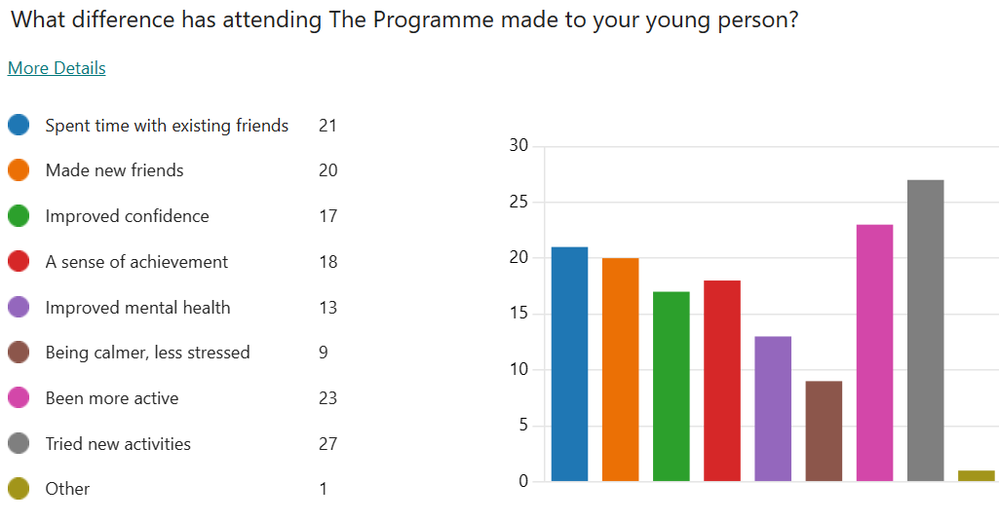
Outcomes for young people

Slide 12
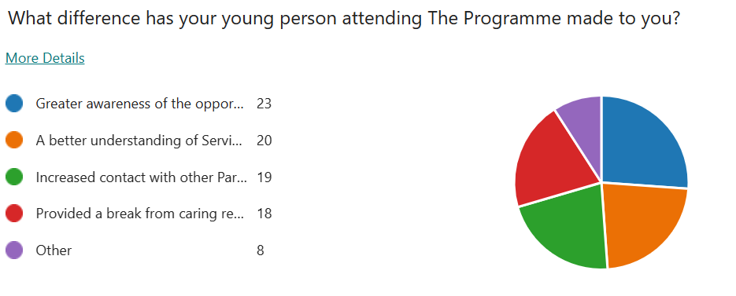
Outcomes for parent carers

Slide 13
PACC would like to say a huge thankyou to all of the Activity Providers who have supported The Programme and ensured all Young People enjoyed their activities! And a big thankyou to PACC volunteers for all of their support making this programme possible!

Slide 14
Healthy Lives Programme 2023
Celebration Event
Information & Support, Influence & Change

Slide 18
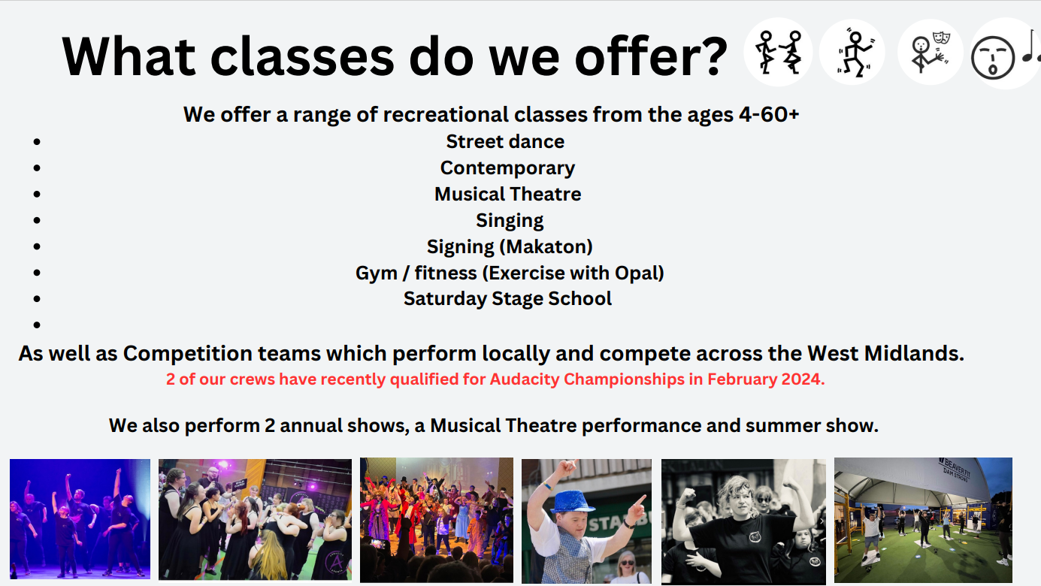

Slide 20
Learning and Next Steps
Information & Support, Influence & Change

Slide 21
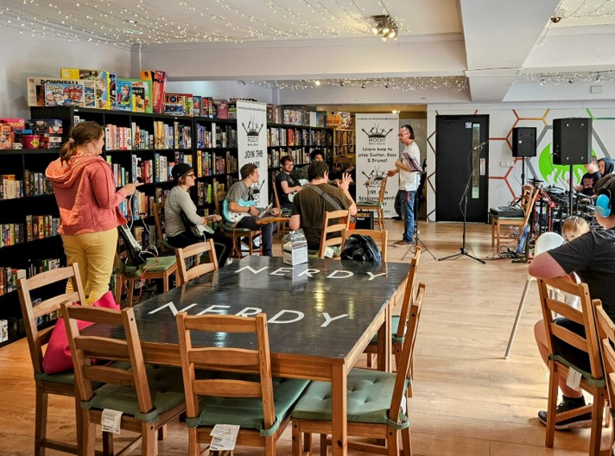
Learning and Next Steps
young people from the learning disability and autistic community want to do the same type of activities as their neurotypical peers, but they want to do this in a safe and supported environment, where they can spend time with their friends
Over 82% were repeat participants from last year’s programme and the growth in friendships was clearly key in supporting participation.
Parents reported growing confidence in building and supporting the development of friendship circles.
There is a significant opportunity to use the Healthy Lives Programme as a gateway to Post 16 provision, providing co-ordinated information about the Post 16 offer and taster sessions to support transition.

Slide 22
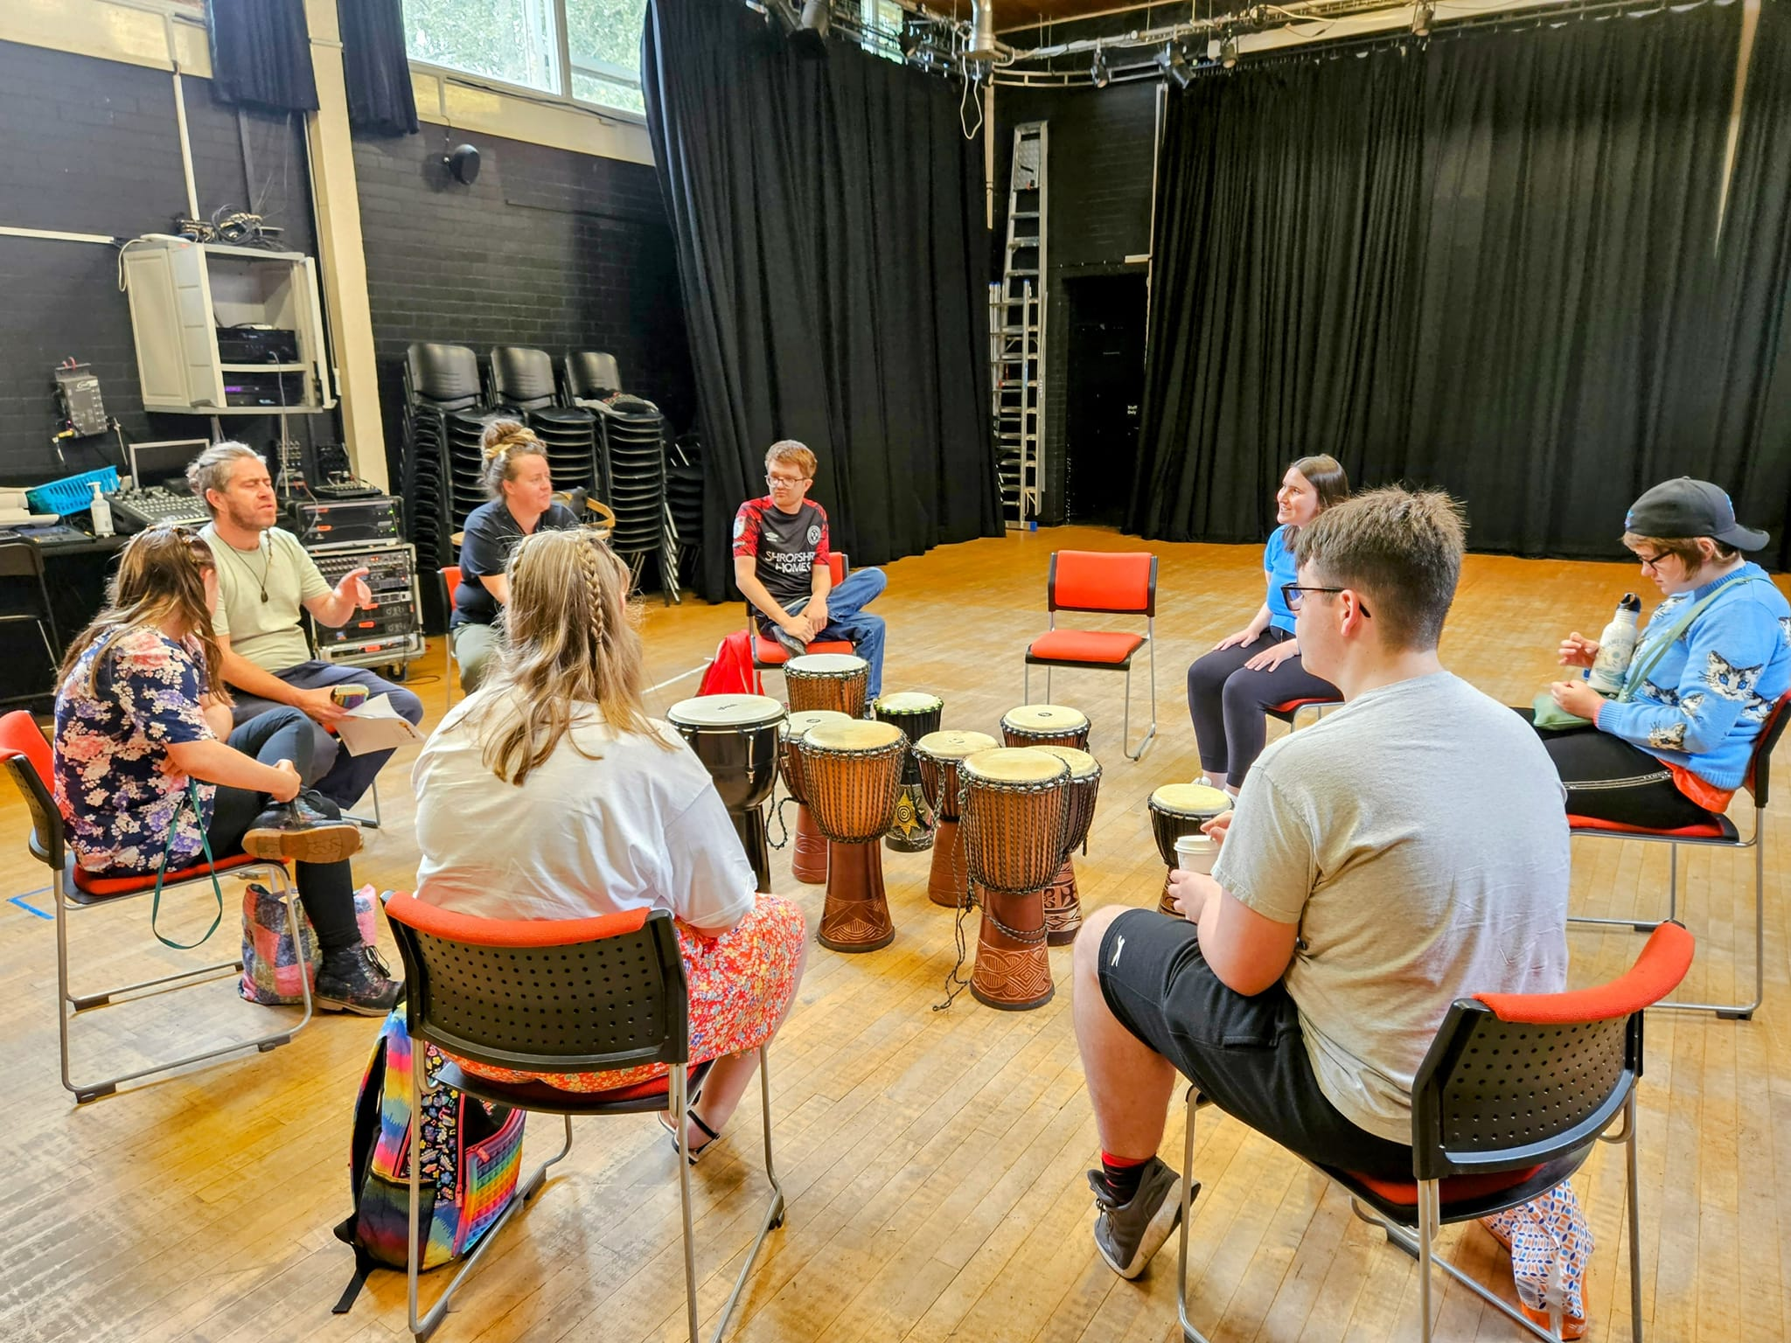
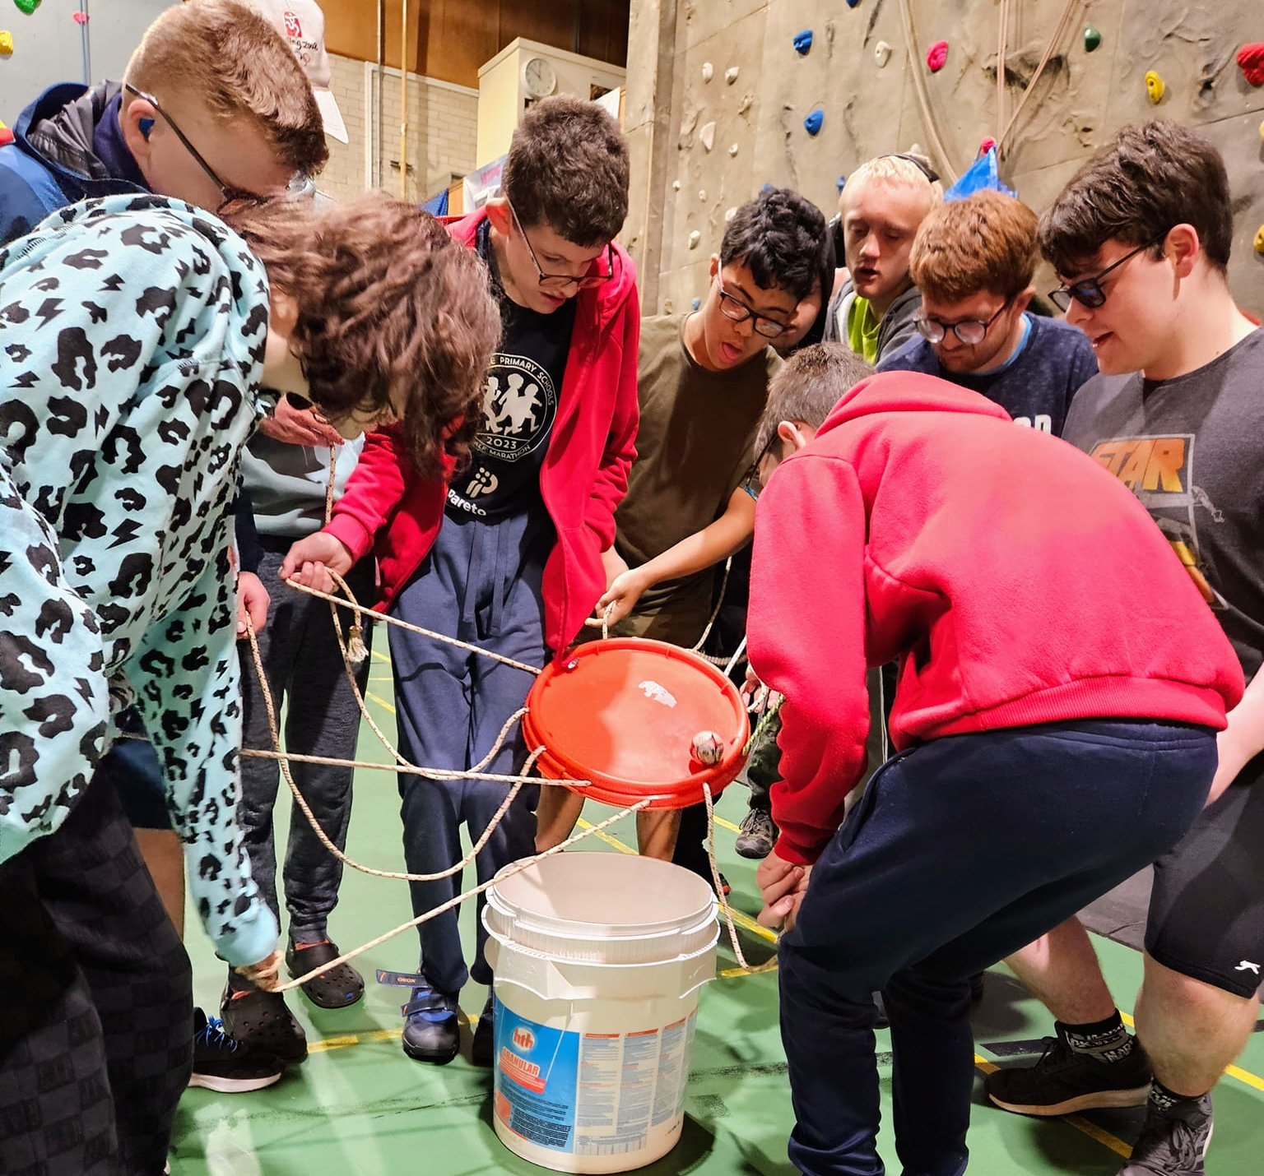
Learning from Healthy Lives will continue to inform the development of PFA Hubs in Shropshire, linking existing venues throughout the county, with community-based activity providers.
Further work is needed to create a wider physical activity offer for SEND families to support improved health outcomes.
There are clear opportunities to develop a community-based Short Break programme aimed at 14 – 25 years with more complex needs, supporting transition to adult services, while providing regular breaks from caring from parent carers.
The key to the success of programme is the hours invested in developing relationships with both providers and families.

Slide 23
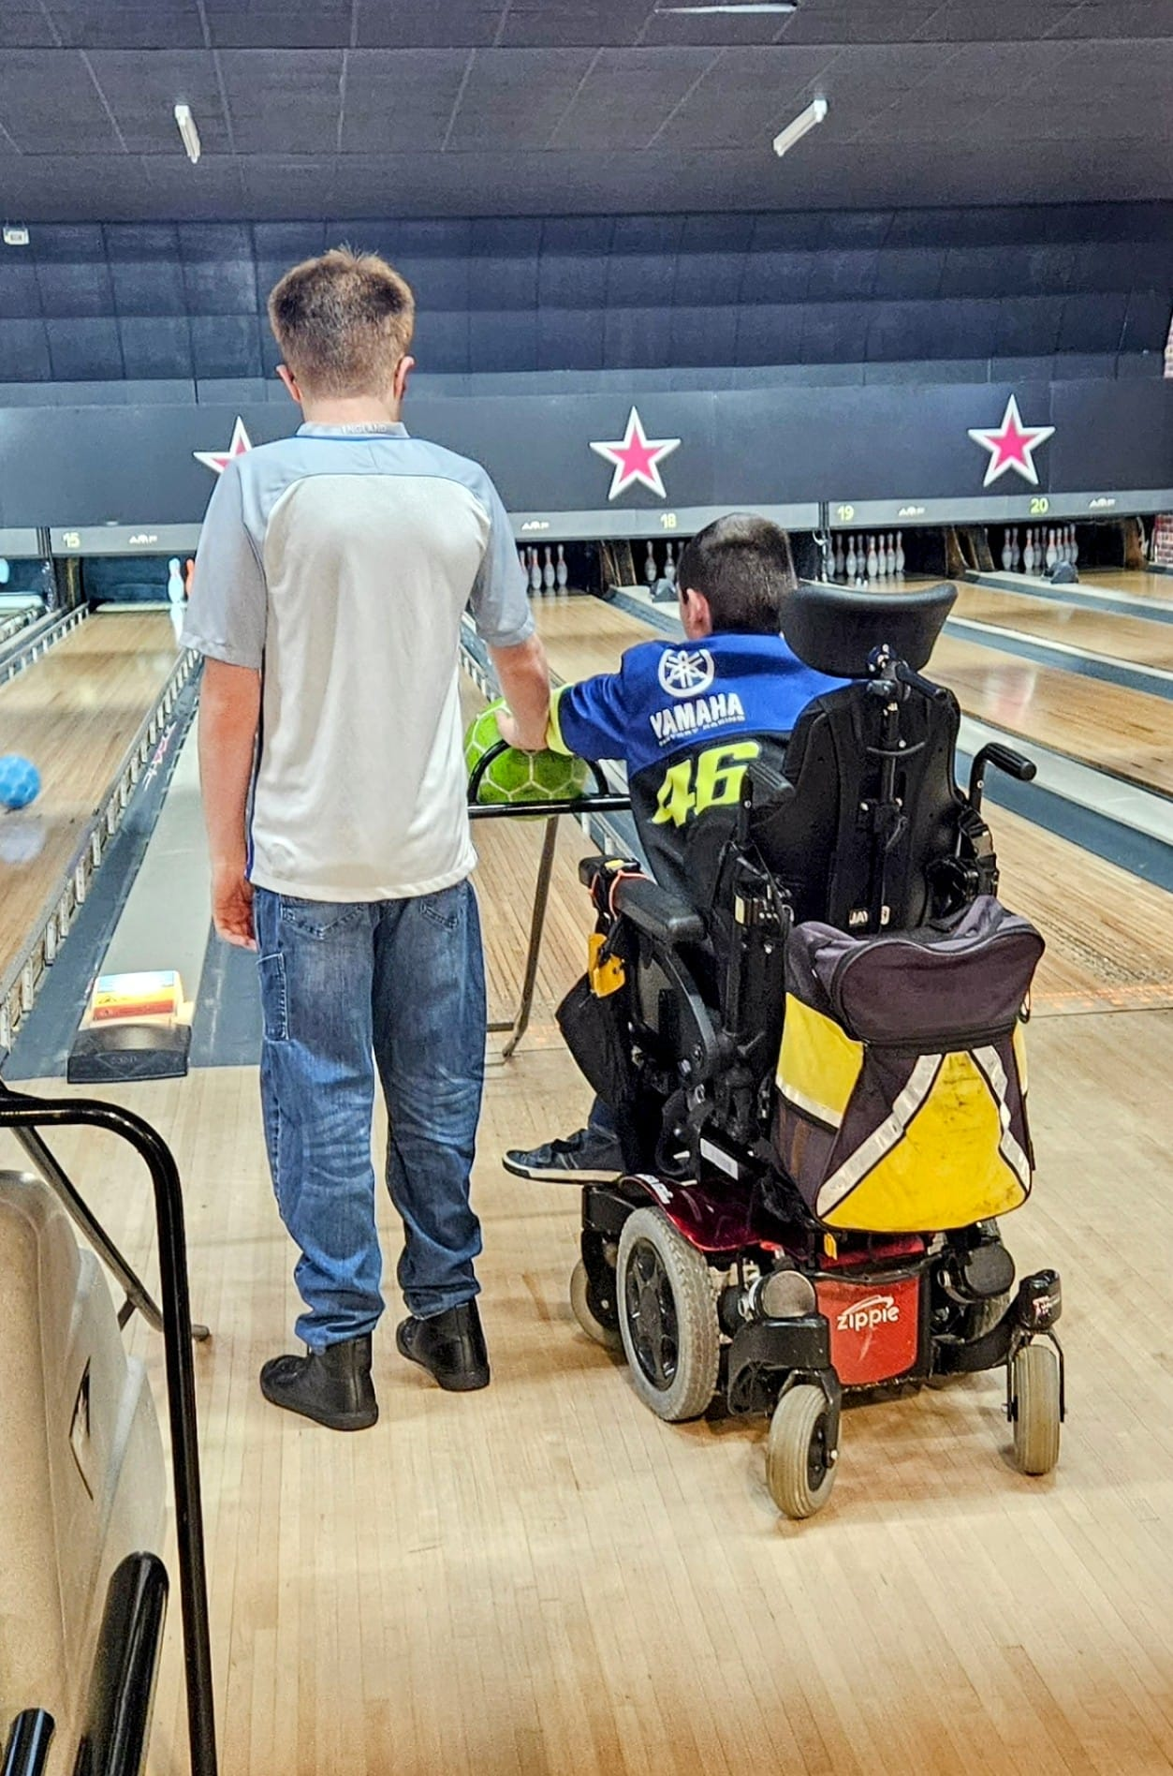
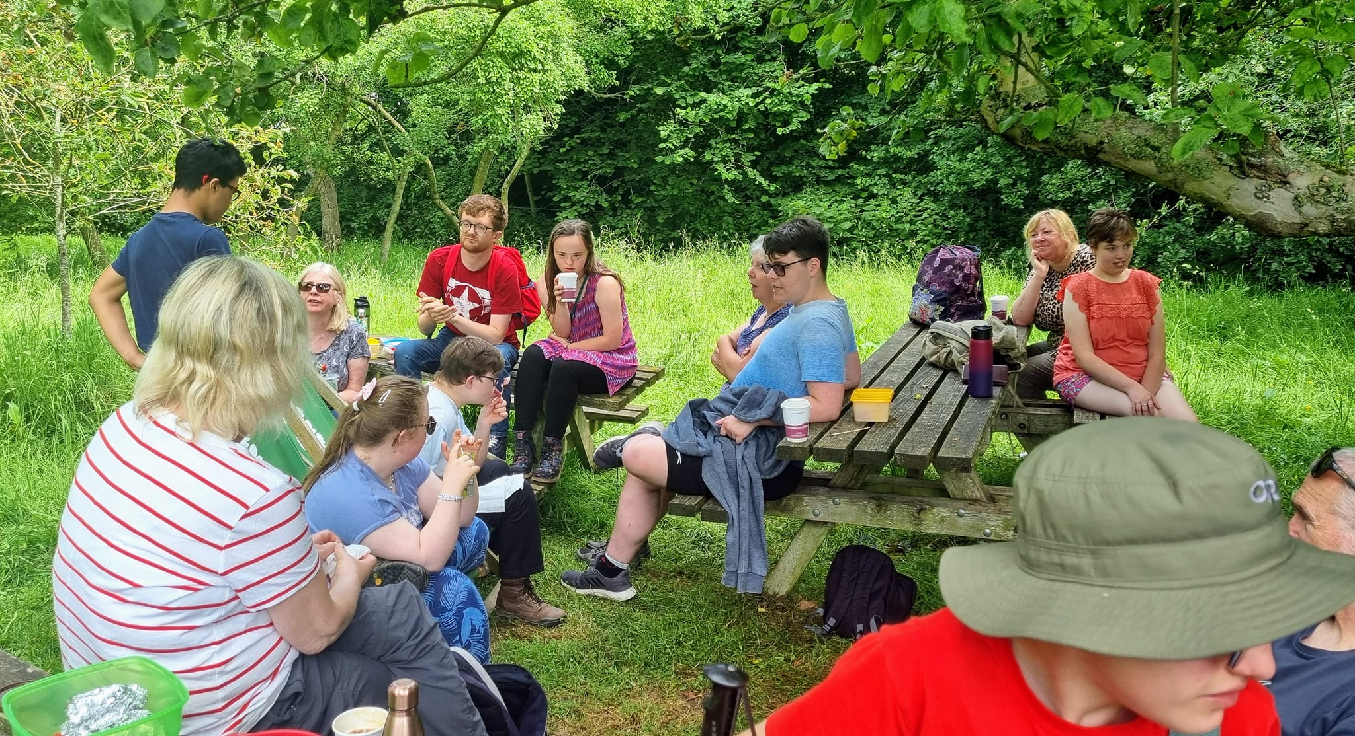
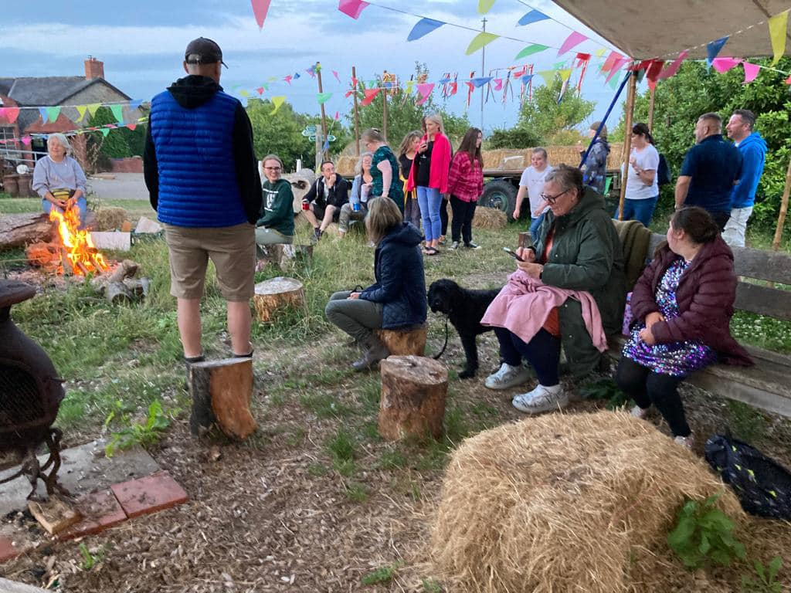
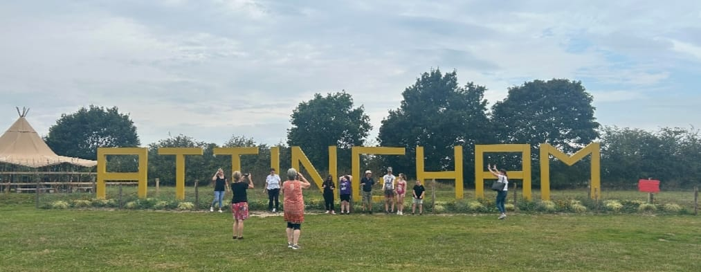
Buddies Social Network
Buddies is a social network for families of children 14-25 years with special educational needs or disabilities, supported by PACC. The group provides an opportunity for young people with SEND to get together socially and develop friendships outside of their educational provision.
Having the parent carer led Buddies programme (hosted by PACC) provides important opportunities throughout the year for the young people who participate in the Healthy Lives programme and their parent carers to keep in touch. Buddies also provides an entry pathway in the Healthy Lives programme.

Slide 24
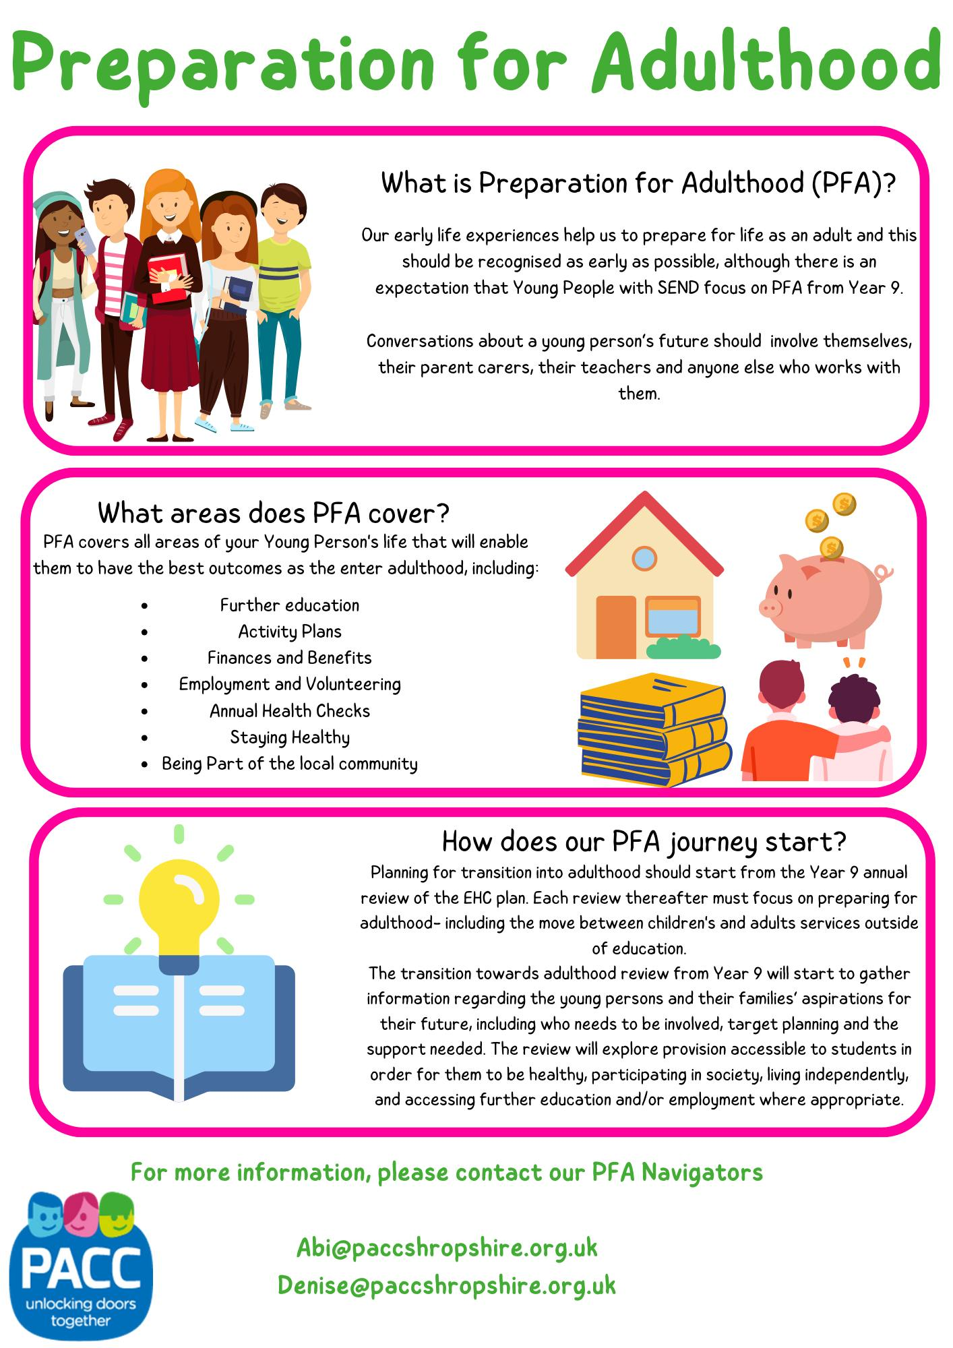
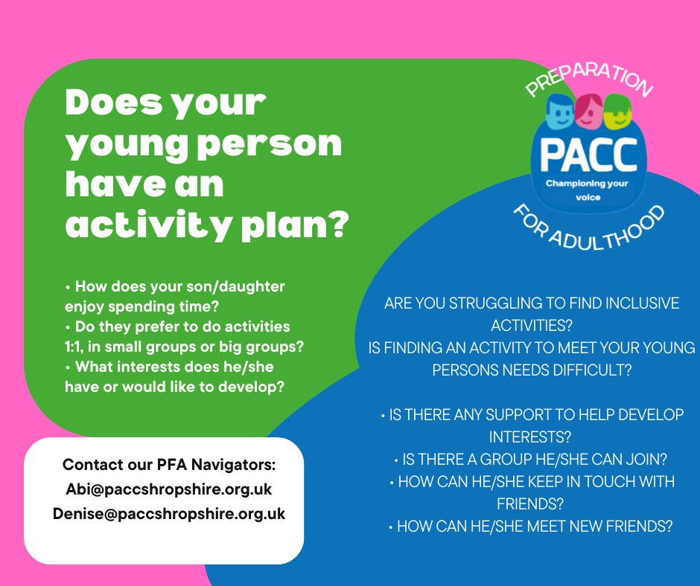
PFA Navigators
Abi and Denise can offer information and signposting to PFA services. They will be here until 1pm to chat all things PFA!

Slide 25
Shrewsbury Town Football Club have kindly donated tickets for a home game in January to Young People who have been awarded a certificate today!
For more information, or to reserve tickets, please speak to Abi!

Slide 26
We would like to say a huge thank you to........
Funders of The Healthy Lives Programme
Providers who were part of this year's programme
All the Young People who attended this year's programme
The team at PACC for organising this year's programme
Brad Fitt for coming to Shrewsbury to support this years event

